Slide 1
A PRESENTETION ABOUT HYDROLOGICAL CATCHMENT DELINEATION AND RUN-OFF MEASUREMENT PROJECT & A DEVELOPED PROFFESSIONAL GRAPHICAL USER INTERFACE (GUI).
USING MATLABSOFTWARE

Slide 2
PRESENTED BY GROUP 11 MEMBERS.
NAME | REGISTRATION NUMBER | PROGRAM OF STUDY | SIGNATURE
MUKYALA ROSE MIIRIAM | BU/UP/2024/1041 | WAR
OGWANG EMMANUEL | BU/UP/2024/3254 | WAR
NSAMBA SHAFFIC | BU/UP/2024/5346 | MEB
KAGODA ENOCK | BU/UP/2023/1097 | WAR
BUSUULWA HASSAN | BU/UP/2024/3732 | AMI
WAMBI KENNETH | BU/UP/2023/0950 | PTI
ATWIINE SANDRAH | BU/UG/2024/2632 | MEB
ABESIGA KEITH ADAMS | BU/UP/2024/3974 | AMI
WASSWA FRANCIS | BU/UG/2024/2669 | APE
NANDERA JULIET | BU/UP/2024/1047 | WAR

Slide 3
INTRODUCTION
Hydrological catchment delineation and run-off measurement.
This project involves defining the land area that contributes water to a specific outlet and quantifying the water flowing from it. This work is essential for water resource management, hydraulic structure design, and flood prediction.
It also involves different research key terminologies, systems, design and methods of data collection carried out by group11 members about the hydrological catchment delineation and run-off measurement project

Slide 4
HYDROLOGICAL CATCHMENT DELINEATION
Catchment (watershed or drainage basin) delineation is the process of defining the boundary where all precipitation drains to a single, common outlet or pour point.
METHODS:
Manual Method:
Involves using topographic maps, identifying high points (ridges) and drawing boundary lines perpendicular to the contour lines, ensuring the boundary does not cross any streams except at the outlet.
Digital/GIS Method (Most Accurate):
Uses a Digital Elevation Model (DEM) and specialized software (e.g., ArcGIS, QGIS, HEC-HMS, and WEAP). The general steps include:
  Acquire and condition the DEM:
Fill sinks (correct imperfections in the elevation data).
Calculate Flow Direction:
Determine the path water will take from each cell (pixel) in the DEM.

Slide 5
Methods continuation
Calculate Flow Accumulation:
Determine the number of upstream cells that drain into each cell; high accumulation areas usually indicate stream channels.
Define the Pour Point (Outlet):
Specify the exact location on the stream network for which the catchment is being delineated (e.g., a dam, a bridge, or a gauge station).
Run the Watershed Tool:
The software uses the flow direction and pour point data to automatically generate the catchment boundary as a raster, which can then be converted into a polygon for area calculation and further analysis.

Slide 6
RUN-OFF MEASUREMENT
Run-off measurement quantifies the volume and rate of surface water flow. This can be done in the field (direct measurement) or through modeling (estimation).
Methods
Area-Velocity Method:
Involves measuring the cross-sectional area of a river and the water velocity (using current meters or flow probes) at various points to calculate discharge (volume per time).
  Weirs and Flumes:
Installing standardized hydraulic structures (weirs or flumes) in a channel, where flow rate can be determined by measuring the water level (stage).
  Tracer Dilution Methods:
Injecting a known concentration of a chemical tracer (like salt) into a stream and measuring its dilution downstream to calculate flow rate, useful for turbulent or irregularly shaped channels where current meters are difficult to use.
  Water Level Recorders:
Using instruments like ultrasonic sensors or float-and-counterweight systems in stilling wells to continuously record water levels, which are then correlated with discharge measurements to create a rating curve.

Slide 7
MODELING AND ESTIMATION
Runoff Coefficient Method (Rational Method):
A simple empirical method that uses a coefficient (C) representing the land cover's permeability to estimate runoff volume from precipitation.
SCS Curve Number (SCS-CN) Method:
A widely used method by the Natural Resources Conservation Service to estimate the depth of direct surface runoff for a given rainfall event, considering soil type and land use.
Hydrological Models (e.g., HEC-HMS, SWAT):
Computer models that simulate the entire hydrological cycle, using various data inputs (precipitation, land cover, soil type, DEM) to generate detailed runoff hydrographs and predict flood events.

Slide 8
. PROJECT COMPONENTS
The project involved the following components;
Data Collection:
Gathering topographic maps or a high-resolution DEM, land use/cover data, soil data, and long-term rainfall data from weather stations. Data was obtained from different websites like kaggle.com
Catchment Delineation:
Using the methods above to define the study area boundaries and sub-basins.
Run-off Analysis:
Measuring or modeling run-off to understand the quantity, quality, and timing of water flow, often resulting in a runoff hydrograph.
Reporting and Application:
Using the results for planning drainage infrastructure, designing flood control measures, or assessing water availability.

Slide 9
GRAPHICAL USER INTERFACE (GUI):
This is an application developed to run different input data coded in to MATLAB.WE designed it in order to simplify and quickly have targeted data access about the project.

Slide 10
CODE GENERATION
The code was generated following the ideas of classes, subclasses, encapsulation, inheritance, and polymorphism depending on the different datasets obtained from Kaggle.com based on a land site DEM dataset of Rwanda and Sponge –Village Run-off dataset.
We needed to build a hydrological simulation system capable of:
- Loading rainfall–runoff datasets.
- Loading DEM (Digital Elevation Model) data.
- \Processing the data visually and numerically.
Designing a MATLAB GUI that integrates these functions

Slide 11
STEPS INVOLVED
Step.1 data set identification.
It represents the data requirements and problem analysis phase were we examined the structure, type and format hydrological data sets before building any code i.e. Rainfall dataset (Excel file) and DEM dataset folder
. Step.2 Preprocess.
It involves creating a clean DEM to correctly compute run-off, flow routing, watershed shape and drainage networks
Step.3. DEM pour point.
It inputs and defines the outlet (pour points) of the catchment (Rwanda DEM). It also indicates the exact location of the pour point and a hydrologically-correct DEM to the actual delineate water shed
Step.4.Delineate catchment.
It creates the boundary of the catchment based on the DEM and pour point. It ensures that hydrological models must run only on the catchment area, not the whole DEM.
Step.5. Compute area.
It quantifies the characteristics needed by hydrological models for computing catchment physical properties..

Slide 12
CLASSES & SUB CLASSES
Catchment model
Hydro model
Rational model
Run-simulation dataset
soil conservation service curve number method

Slide 13
GRAPHS INVOLVED

Slide 14
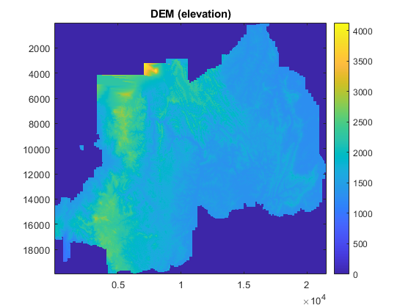

Slide 15
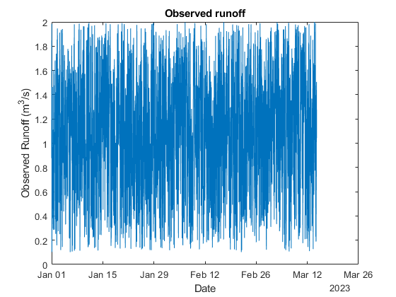

Slide 16
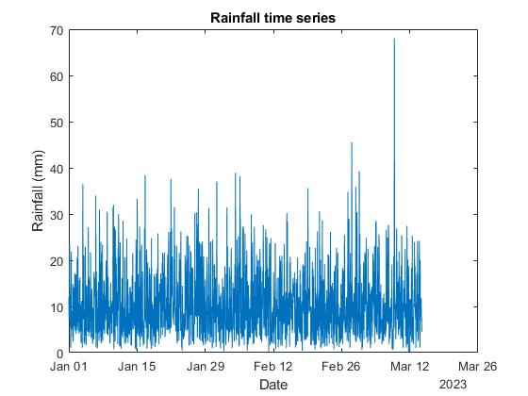

Slide 17
CONCLUSION
The assignment was successful since there was maximum cooperation among group 11 members. It exposed us to the different computation skills, engineering and design knowledge. Through this assignment we were exposed on different methods of data collection i.e. from Kaggle.com and how to manipulate and visualize it.

